Slide 1
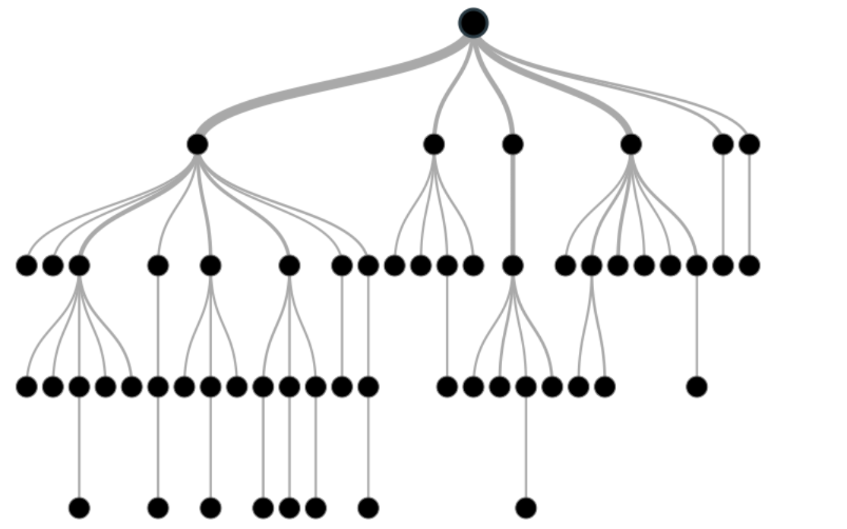
DECISION TREES AND RANDOM FORESTS
By:
Monica Dasi (1343737)
Course : Learning From Data
Guided by : Prof. Dr. Martin Simon
Summer Semester : 2022

Slide 2
Agenda
Decision Trees
Terminology
Attribute Selection Methods
Decision Tree Algorithms
Random Forests
Implementation
Summary

Slide 3
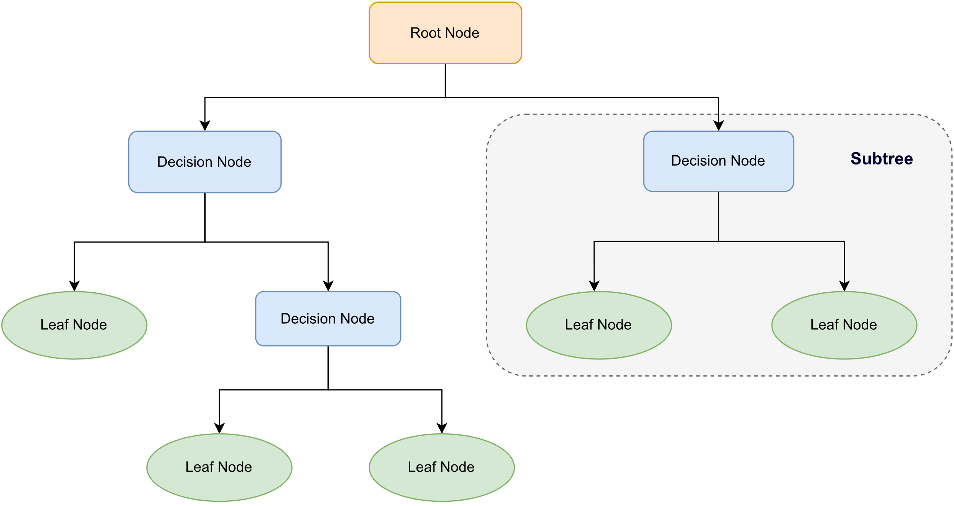
Decision Tree
Classification
Regression
[1] ibm.com/topics/decision-trees
[2] analyticsvidhya.com/ways-split-decision-tree

Slide 4
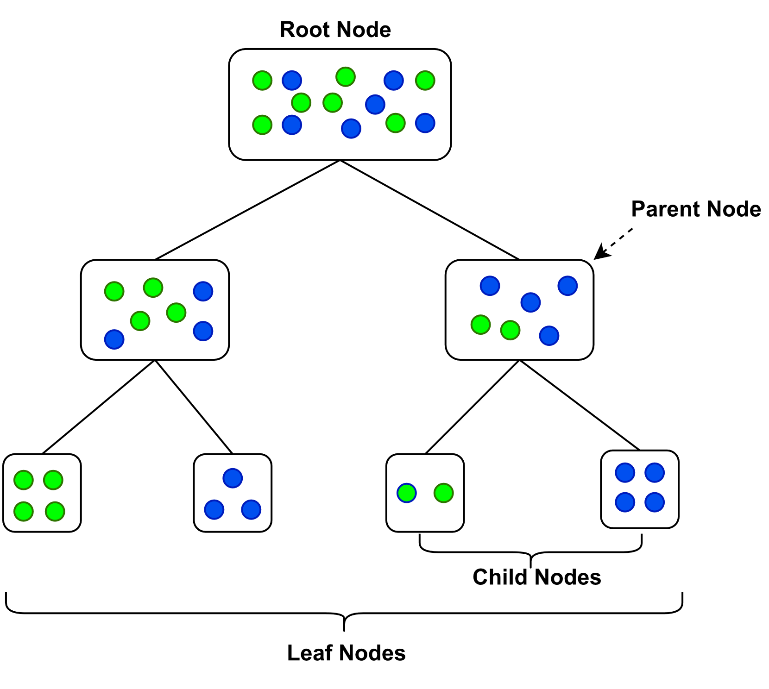
Terminology
Root Node
Parent and Child Node
Leaf / Terminal Nodes
Decision Node
Splitting
https://www.analyticsvidhya.com/blog/2020/06/4-ways-split-decision-tree/

Slide 5
Attribute Selection Methods
Splitting rules to decide how the features are going to split.
Used to partition the dataset in best possible way.
Gini index
Entropy
Information gain
Gain Ratio
Reduction in Variance
Chi-Square
Source : AttributeSelectionMethods

Slide 6
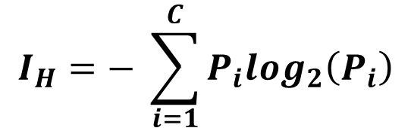
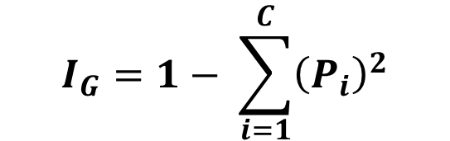
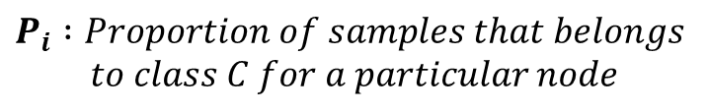
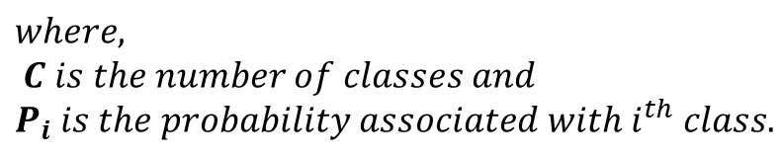
Impurity Criterion
Gini
Entropy
Gini impurity measures how often a randomly chosen attribute is misclassified.
Measure of impurity or randomness in the data points.
$$I_{H}=− \sum_{i=1}^{C}{P_{i}\log_{2}\left(P_{i}\right)}$$
$$I_{G}=1− \sum_{i=1}^{C}{{\left(P_{i}\right)}^{2}}$$
$$where,$$
$$C is the number of classes and$$
$$P_{i} is the probability associated with i^{th} class.$$
$$P_{i} :Proportion of samples that belongs$$
$$to class C for a particular node$$

Slide 7
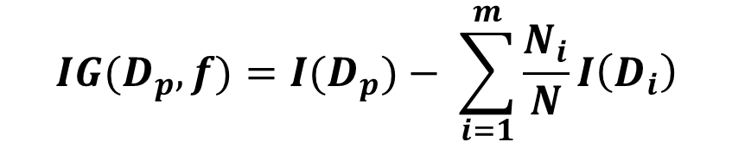
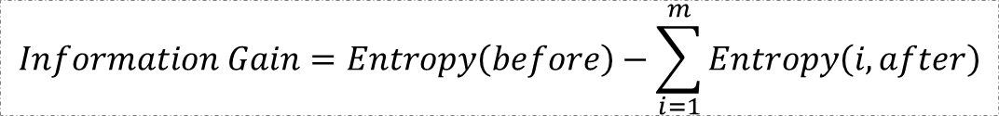
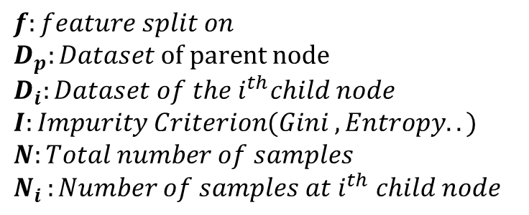
Information Gain
$$IG(D_{p},f)=I(D_{p})− \sum_{i=1}^{m}{\frac{N_{i}}{N}I\left(D_{i}\right)}$$
Low Information
Gain
High Information
Gain
$$f:feature split on$$
$$D_{p}:Dataset of parent node$$
$$D_{i}:Dataset of the i^{th}child node$$
$$I:Impurity Criterion(Gini , Entropy..)$$
$$N:Total number of samples$$
$$N_{i }:Number of samples at i^{th} child node$$
$$Information Gain=Entropy\left(before\right)−\sum_{i=1}^{m}{Entropy\left(i,after\right)}$$
becominghuman.ai/decision-trees-in-machine-learning

Slide 8
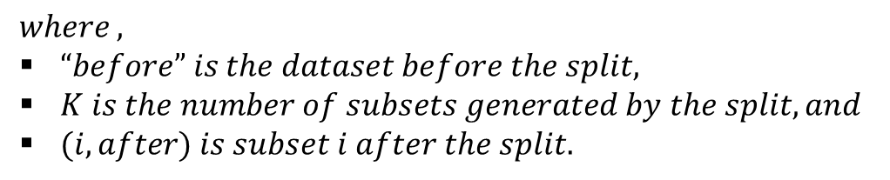
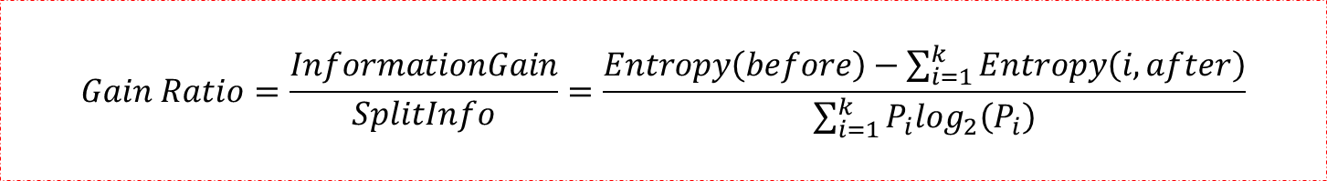
Gain Ratio
$$Gain Ratio=\frac{InformationGain}{SplitInfo}=\frac{Entropy\left(before\right)−\sum_{i=1}^{k}{Entropy\left(i,after\right)}}{\sum_{i=1}^{k}{P_{i}\log_{2}\left(P_{i}\right)}}$$
$$where ,$$
$“before” is the dataset before the split,$
$K is the number of subsets generated by the split, and$
$(i, after) is subset i after the split.$

Slide 9
Decision Tree Algorithms
CLASSIFICATION
REGRESSION
THAID – 1st classification algorithm
Classification and Regression Trees (CART)
Iterative Dichotomiser 3 (ID3)
C4.5
CHAID
QUEST
CRUISE
GUIDE Classification
Automatic Interaction Detection (AID) (1st regression algorithm)
M5
GUIDE Regression
Source : https://medium.datadriveninvestor.com/decision-tree-algorithm-with-hands-on-example-e6c2afb40d38

Slide 10
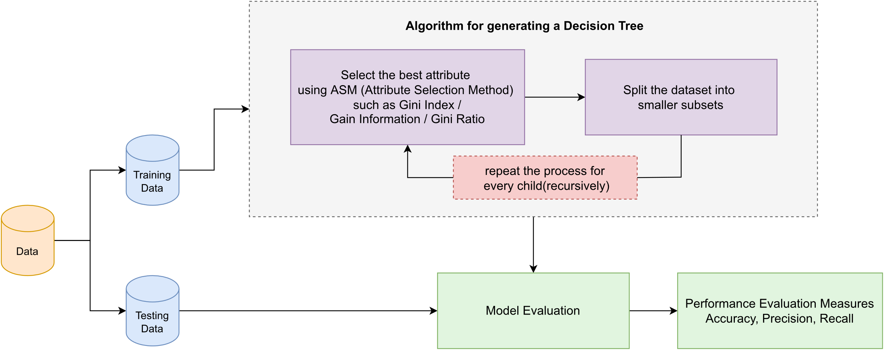
Decision Tree Generation
$Training Vectors x_{i}∈R^{n}$, $i = 1,….l and a label vector y$ $∈R^{l}, a decision tree recursively partitions$
$the feature space such that the same labels or similar target values are grouped together$.
Source: Decision Tree Generation

Slide 11

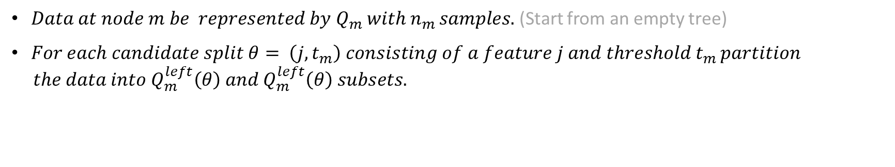
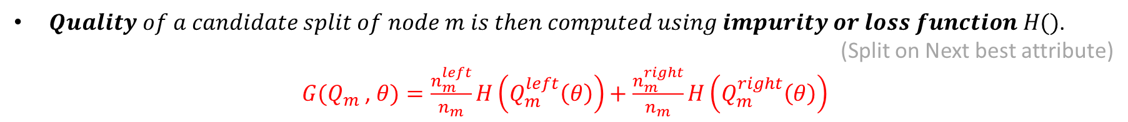

Decision Trees – The Algorithm
$Data at node m be represented by Q_{m} with{ n}_{m }samples.$ (Start from an empty tree)
$For each candidate split θ= \left(j,t_{m}\right) consisting of a feature j and threshold t_{m }partition$
$$the data into Q_{m}^{left}\left(θ\right) and Q_{m}^{left}\left(θ\right) subsets.$$
$$Q_{m}^{left}\left(θ\right)=\left\{\left(x,y\right) | x_{j}≤t_{m}\right\}$$
$$Q_{m}^{right}\left(θ\right)=Q_{m}∖Q_{m}^{left}(θ)$$
$Quality of a candidate split of node m is then computed using impurity or loss function H()$.
(Split on Next best attribute)
$G(Q_{m}$, $θ)=\frac{n_{m}^{left}}{n_{m}}H\left(Q_{m}^{left}\left(θ\right)\right)+\frac{n_{m}^{right}}{n_{m}}H\left(Q_{m}^{right}\left(θ\right)\right)$
$Select the parameters that minimises the impurity$.
$$θ^{∗}={argmin}_{θ}G(Q_{m} \text{, }θ)$$
$Recurse for subsets\left(Q_{m}^{left}\left(θ^{∗}\right)\right)and\left(Q_{m}^{right}\left(θ^{∗}\right)\right)until maximum allowed depth is reached.$
https://scikit-learn.org/stable/modules/tree.html#tree-algorithms-id3-c4-5-c5-0-and-cart

Slide 12
CART (Classification and Regression Trees) — uses Gini impurity as the metric
Is a recursive training algorithm developed by Breiman et.al in early 80’s.
Uses greedy search of AID and THAID
Supports numerical target variables (regression)
Each node is split in such a way that weighted average of the Gini of the children is minimized.
Constructs binary trees using the ‘feature’ and ‘threshold’
that yield the largest information gain at each node.

Slide 13
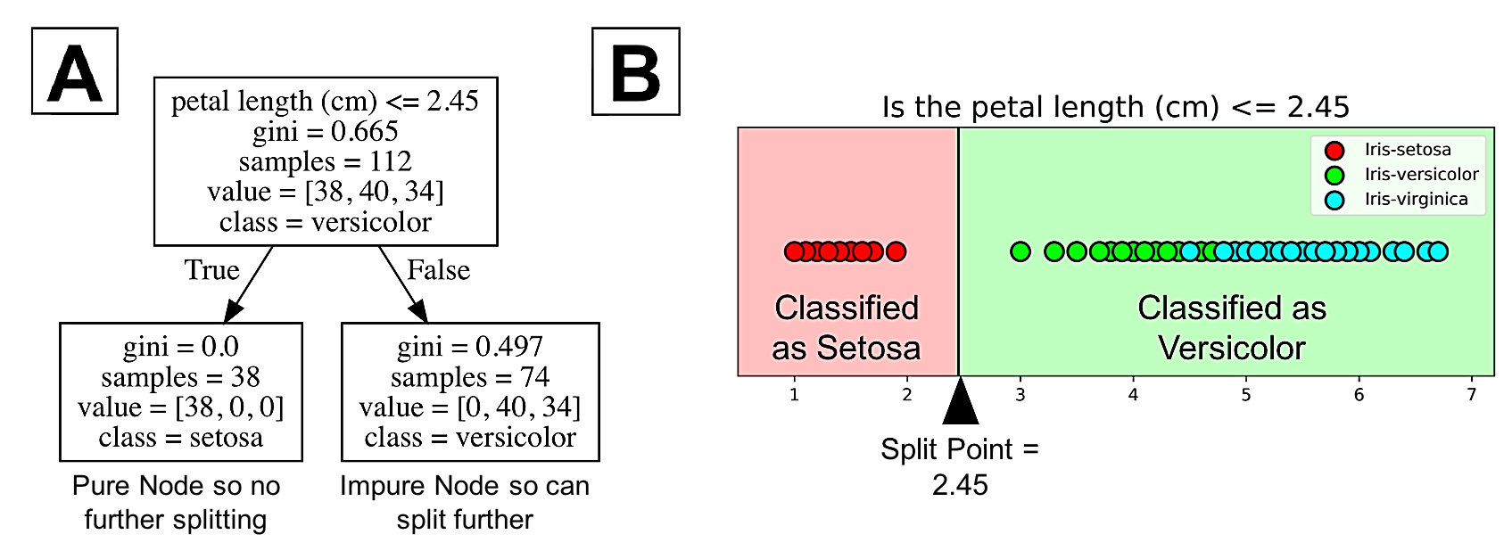
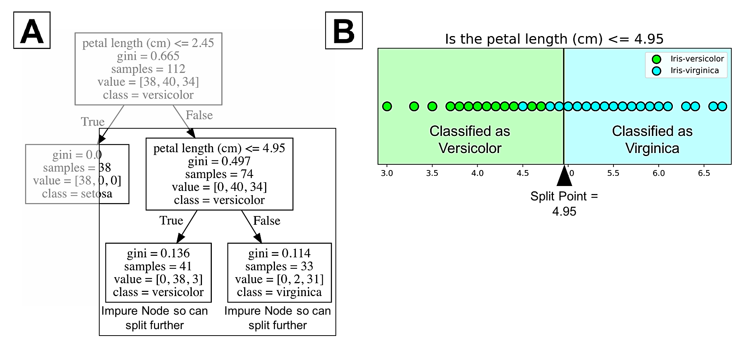
Source : https://towardsdatascience.com/understanding-decision-trees-for-classification-python-9663d683c952

Slide 14
ID3 Algorithm
C4.5 Algorithm
Follows a greedy approach by selecting a best attribute that yields maximum Information Gain(IG) or minimum Entropy(H).
Information gain is biased towards choosing attributes with a large number of values as root nodes.
C4.5, an improvement of ID3
Uses Gain ratio which is a modification of Information gain that reduces its bias.
Gain ratio overcomes the problem with information gain by considering the number of branches that would result before making the split.
It corrects information gain by taking the split info into account.

Slide 15
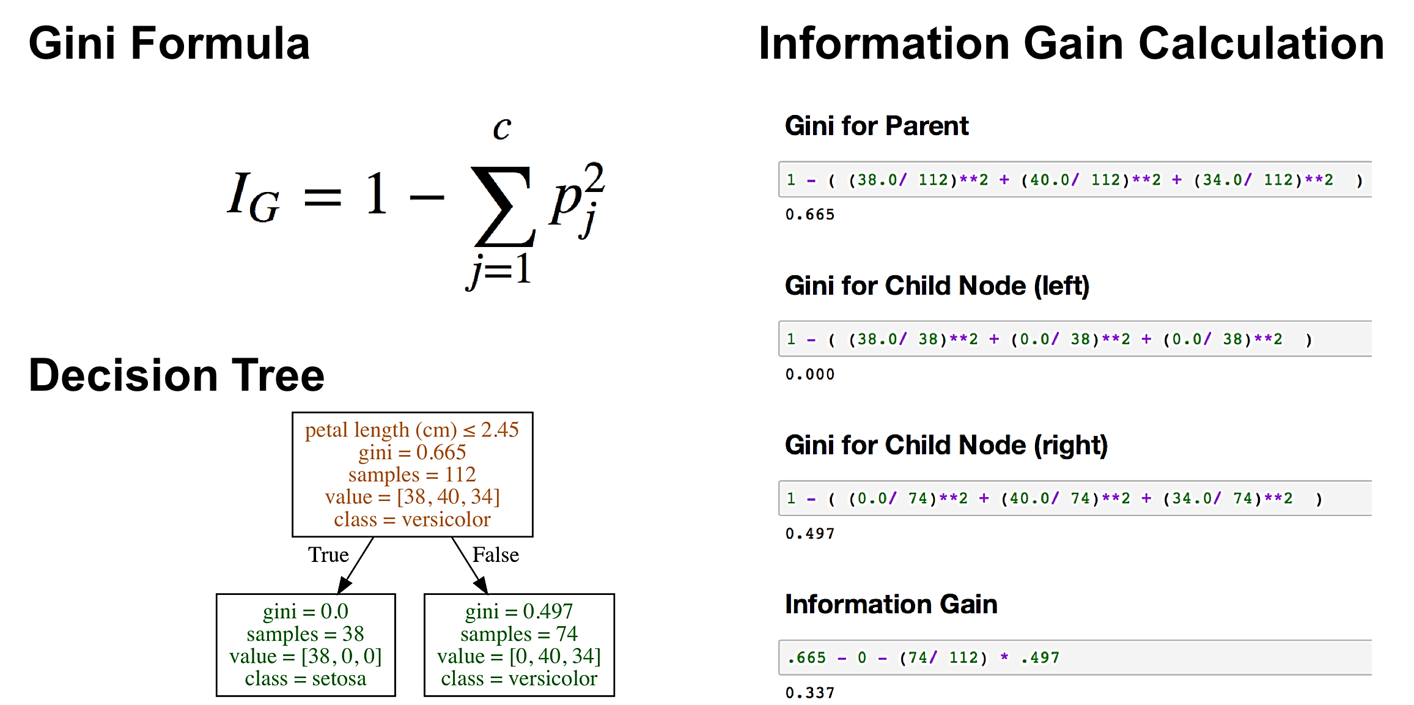

Slide 16
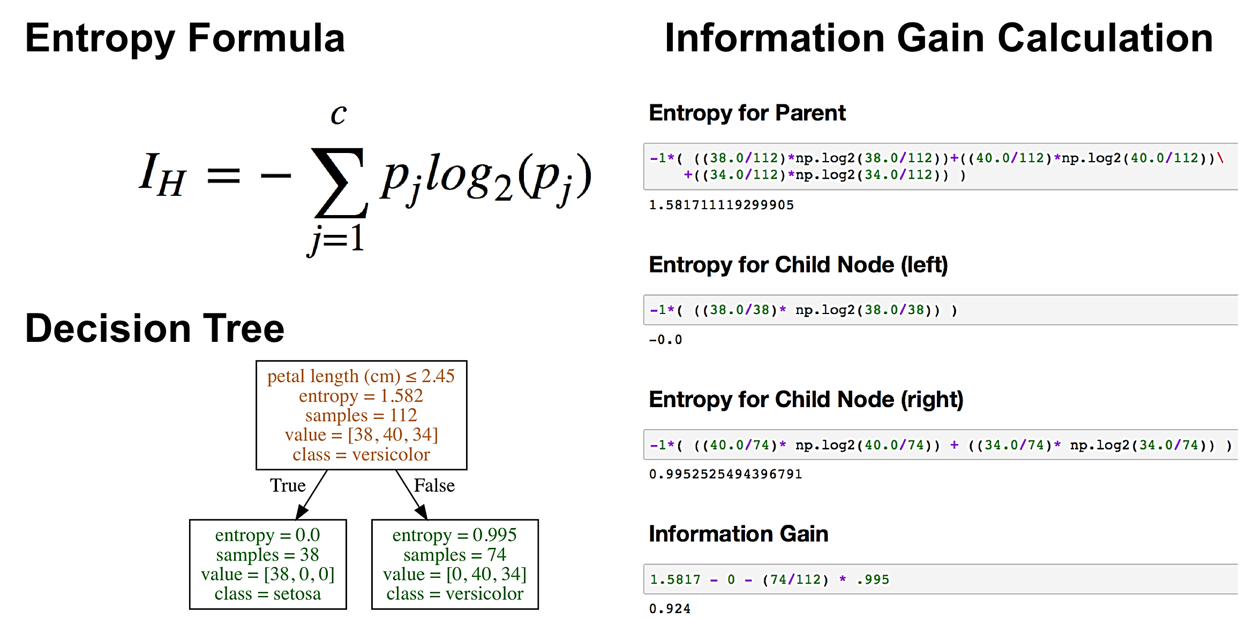

Slide 17
Comparison
Features | CART | ID3 | C4.5
Data type | Continuous and Nominal | Categorical | Continuous and Categorical
Computation Speed | Average | Low | Faster than ID3
Boosting | Supported | Not supported | Not supported
Pruning | Post-Pruning | No | Pre-Pruning
Missing Values | Can handle | Cannot handle | Cannot handle
Split Criteria | Gini Index | Entropy and Information Gain | Split Info and Gain Ratio
Target | Classification and regression | Classification | Classification
Source: https://medium.com/@abedinia.aydin/survey-of-the-decision-trees-algorithms-cart-c4-5-id3-97df842831cd

Slide 18
Random Forests
Decision trees are prone to overfitting, this means that the model is overly complex and has high variance.
Random forest algorithm solves the above challenge by combining the predictions made by multiple decision trees and returning a single output.
This is done using an extension of a technique called bagging, or bootstrap aggregation.

Slide 19
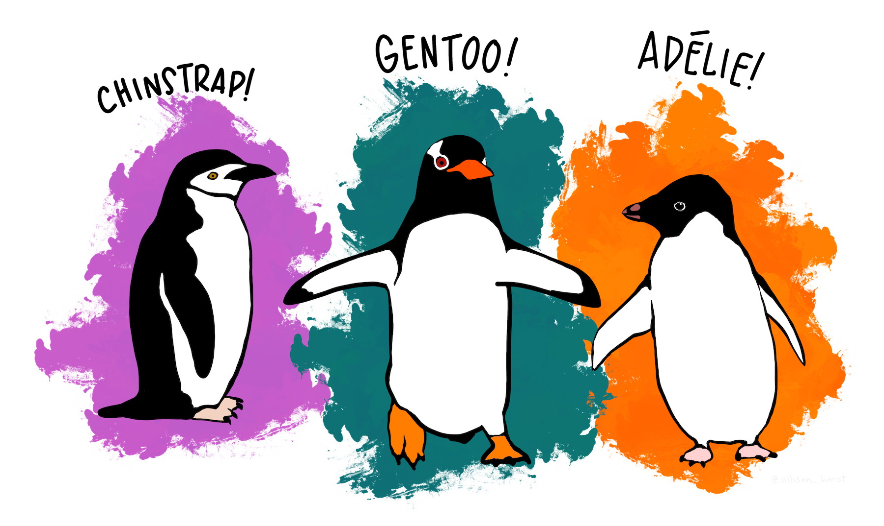
Implementation
palmerpenguins
Dataset : https://allisonhorst.github.io/palmerpenguins/

Slide 20
Summary
Decision trees are simple and easy to interpret.
Can be used for classification and regression problems.
Can partition data that isn’t linearly separable.
Prone to overfitting. Even a small change in the training dataset can make a huge difference in the logic of decision trees.
Random forests solves overfitting by combining the output of multiple decision trees to make a final prediction.
Random forest model will improve accuracy to a certain extent, but also increases computation time.

Slide 21
References
[1] Decision Trees https://www.ibm.com/topics/decision-trees
[2] Decision Tree Classification in Python Tutorial https://www.datacamp.com/tutorial/decision-tree-classification-python
[3] Dataset Reference : Gorman KB, Williams TD, Fraser WR (2014). Ecological sexual dimorphism and environmental variability within a community of Antarctic penguins (genus Pygoscelis). PLoS ONE 9(3):e90081. https://doi.org/10.1371/journal.pone.0090081
[4] J. Ross Quinlan. “Induction of decision trees”. In: Machine learning 1.1 (1986), pp. 81–106
[5] Allison Marie Horst, Alison Presmanes Hill, and Kristen B Gorman. palmerpenguins: Palmer Archipelago (Antarctica) penguin data. R package version 0.1.0. 2020.
doi: 10.5281/zenodo.3960218. url: https://allisonhorst.github.io/palmerpenguins/

